Slide 1
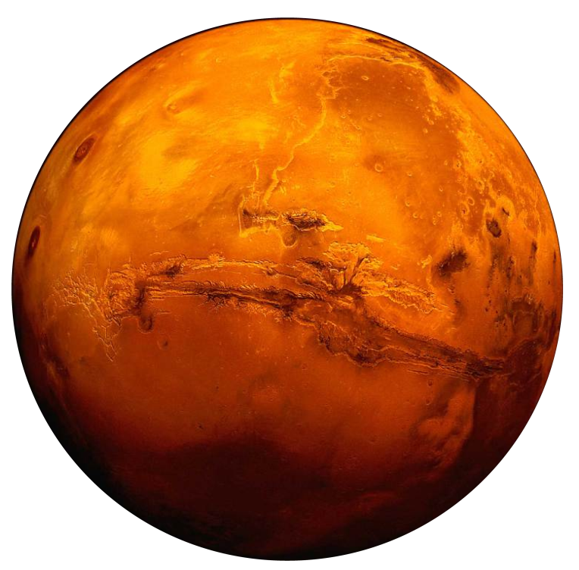

14.1
14.2
UROPs
ADVISORS
NATHAN BOWER
LISA MEEGAN
ALEX SANCHEZ
ERIC WARD
JOSEPH YANG
ARAVIND ASOKAN
TATSUYA DOI
ADRIEN LAWS
CHRIS McCORMICK
GARRETT HOUSE
GREG HUI
BRAD WALCHAR
RYAN WEBB
OLI De WECK
SYDNEY DO
KOKI HO
ANDREW OWENS

Slide 2
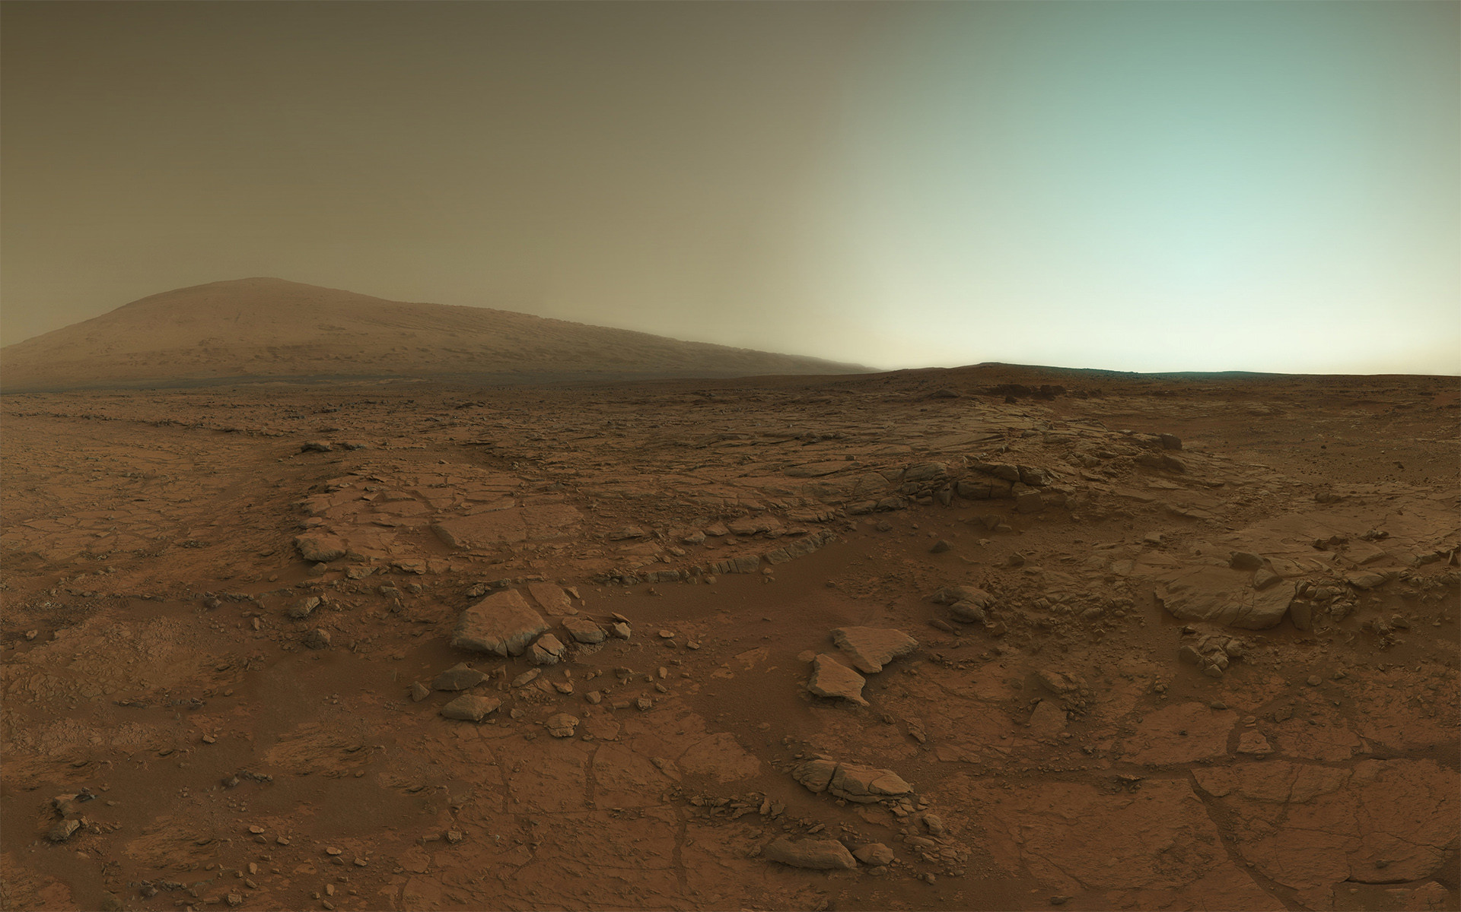
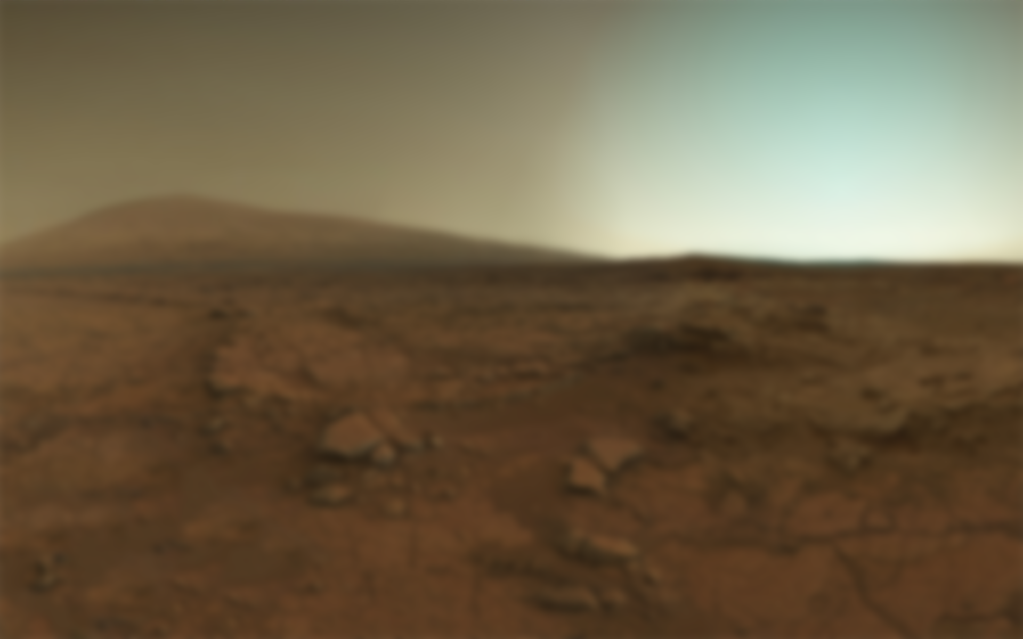

Team 14
To permanently establish the presence of human beings on Mars by safely and stably supporting the lives of astronauts
using sustainable, economical system campaign architecture
Mars Facts
Gravity: 0.376g (Earth: 1g)
Atmosphere:
96% CO2
1.9% Argon
0.145% O2
0.05% CO
Atmosphere <1% thickness of Earth
Travel Time: 6-9 months
Temperature Range
-125 degC to 20 degC
Surface Covered by Rust (iron(III) oxide)
INTRODUCTION & PROBLEM FORMULATION
Notes:
The Mars 2040 mission statement is to permanently establish the presence of human beings on Mars by safely and stably supporting the lives of astronauts using sustainable, economical system campaign architecture. A permanent presence was agreed to be a steady state habitat with 20 people living there. In order to achieve a permanent presence there are multiple phases of the project that must be considered. The Mars 2040 team agreed upon a main objective of looking at the steady state analysis. For our study we make the assumption that all of the required habitation, rovers, equipment, etc has already been to Mars and if fully functional.
We have listed a couple facts about Mars that make it difficult to achieve sustained life on Mars. I would like to point out that the atmosphere on Mars is 96% carbon dioxide which means that an astronaut cannot leave the habitat or pressurized vehicle without an EVA suit. This is also constrains the habitat and rovers. These systems must be completely sealed and must generate oxygen to keep the astronauts alive. In addition to the amount of carbon dioxide in the atmosphere, the density of the Mars atmosphere is 100 times less dense. This will require additional shielding for the habitat and rovers to protect the astronauts from radiation. An additional constraint on our analysis is the fact that it takes 6-9 months just to travel to Mars. This is the travel time during our window of opportunity to get to Mars, which is around every 26 months. This is a key factor when trying to decide whether you are going to supply your food from Earth or grow food on Mars. Finally, Mars is considered the red planet because the surface is covered by Rust or iron(III) oxide. This will make it difficult to grow crops on Mars and will require us to bring our own soil or grow everything using hydroponics technology.

Slide 3
IMLEO
Initial Mass in Low Earth Orbit
ISRU
In-Situ Resource Utilization
EDL
Entry, Descent, and Landing
ECLSS
Environment Control and Life Support System
Delta V
Energy requirements for a space mission
NTR
Nuclear Thermal Rocket
INTRODUCTION & PROBLEM FORMULATION
Notes:
Here are a couple of terms that you will see throughout our presentation.
IMLEO is the initial mass in low earth orbit. This is used to explain the amount of mass that is required to complete the mission. This value is usually directly correlated with the cost of a mission.
ISRU is the In-Situ Resource Utilization. Adrien will go into more detail on our ISRU analysis, but this is the process of using the resources readily available in the atmosphere and soil as fuel, water, etc.
ECLSS is the Environment Control and Life Support System. This is critical to our study because it is the equipment required to keep the astronauts alive. This includes food requirements, water requirements, habitat atmosphere requirements, etc.

Slide 4
Tools/Methods
DESIGN STRUCTURE MATRIX
Activity Based DSM
Define System Interactions
Illustrate Data Flow Direction
TRADESPACE ANALYSIS
Top 20 decisions
Develop Pareto front
OPCAT
Graphical system interactions
Tradespace Model diagram
CONOPS
Resource Map
Verification of tradespace model
SDM METHODOLOGIES USED
Notes:
Many tools were used during the project.
The four tools your see here were utilized the most, but the rest of the examples can be found in the supporting slides.
The tradespace analysis was used as the main focus for this project, with all other tools and methods supporting the tradespace analysis. The main deliverables were determined to be the following:
Suggest the ‘ideal’ campaign scenario from the tradespace that was being analyzed
Develop a tool to quickly analyze the tradespace
In order to develop the tradespace that was being analyzed, the project initially started by putting together a morphological matrix. After the morphological matrix was created the decision was made to reduce the matrix to the top 10 decisions for each team to reduce the amount of overall tradespace variables available. A DSM was then created to determine the interactions between the matrix variables to illustrate the communications that needed to take place in order to complete the tradespace analysis. The project originally started out as two separate teams, therefore the DSM was very useful in showing the communications that needing to take place outside the system boundary for each team along with all communications inside the boundary. After the DSM was completed and the data flow was defined, the decision was made to expand the system boundary and become one team.
As one team we used OPCAT to develop OPM diagrams that directly relate to the input and output requirements of the model that was being developed in Matlab to quickly analyze the tradespace. Finally, the concept of operations were used to make sure all operating scenarios were included in the model. This was used as one method to verify the validity of the model.

Slide 5
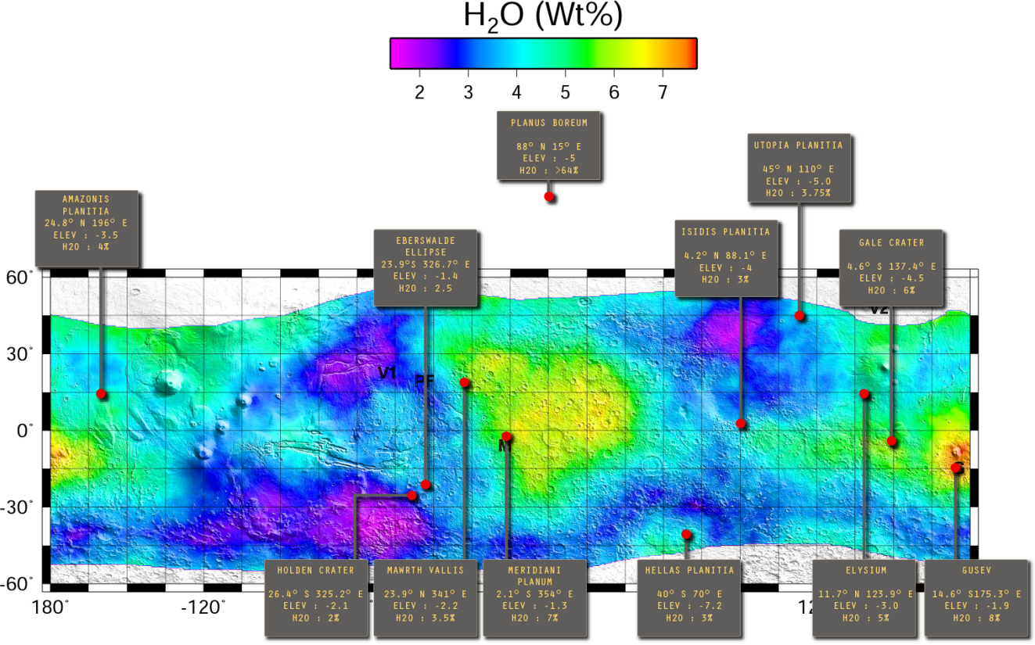
KEY METRICS
Water Availability
ISRU
Elevation
Lower Elevation is more feasible
Latitude,Longitude
Sun
Temperature
SITE SELECTION
Notes:
Now we will briefly explain key decisions in the morphological matrix.
When we go to Mars where will we land? As mentioned previously, the main focus of this project was placed on keeping the astronauts alive in order to achieve a sustained permanent presence on Mars. Therefore when determining what site to land at habitability is our main concern. The following key metrics directly effect the habitability:
- The water availability at each site is critical for the ISRU system. Adrien will explain the importance of the water availability in a couple of slides.
The elevation at each site is critical for landing the payloads and crew on Mars. The lower the elevation is the more mass that can be landed on Mars.
The latitude of each site is critical for sun availability (if using solar power) and temperature range. The astronauts will be in a sealed habitat, but temperature is also important for the ISRU systems and removing the water from the soil.
In addition to researching habitability the team briefly looked at the scientific value of landing at each site. The scientific value for each site is highly dependent on the background of the individual completing the analysis and the amount of “special regions” in the area. A special region is considered to be a region that has the highest possibility for scientific research. The scientific value for each site was compared, but could not be compared quantitatively. Therefore it was left out of the analysis and can be seen in the supporting slides.

Slide 6

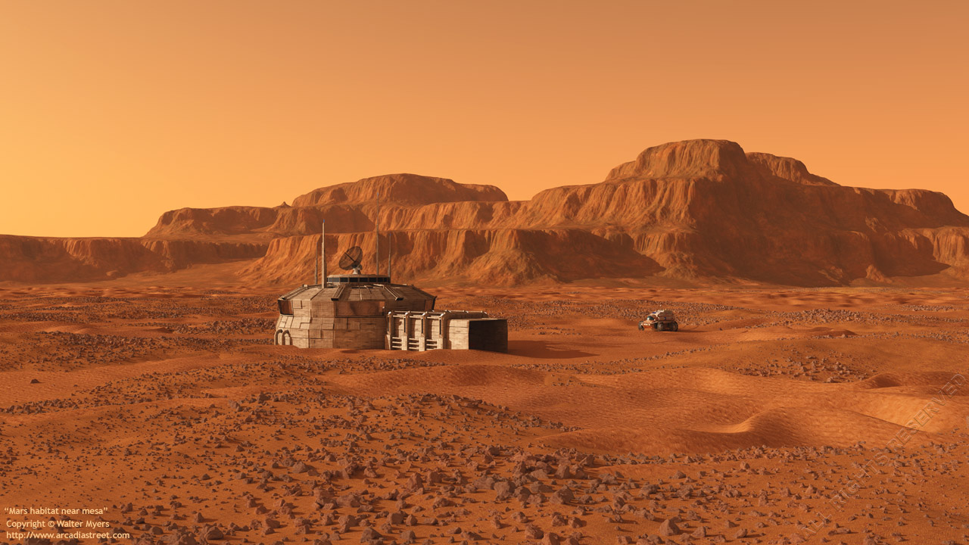
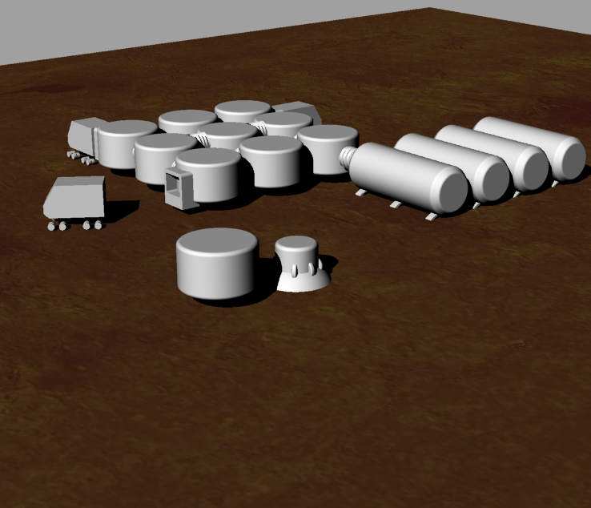
ZONES
Zone 1: Surface Habitat
Crew Quarters
Zone 2: Power & ISRU
Nuclear Radiation Protection
Zone 3: Landing
Surface Habitat Protection
Zone 4: Launch
Debris protection
PLACEHOLDER – WILL CHANGE
SURFACE ARCHITECTURE
Notes:
Once you know the landing site an analysis needs to be completed to determine the surface architecture layout. When determining the surface architecture layout the focus was placed on meeting the overall requirements of the layout. A few requirements include:
The habitat must have a crew quarter for sleeping, exercising, growing food, etc.
The habitat must have a source of power
There must be a landing and launch site at the habitat for the resupply of consumables and spares along with the rotation of astronauts
During our analysis we concluded that the surface architecture must be split into four zones for the safety of the astronauts. Zone 1 will be used for the crew quarters and will consist of the sleeping quarters, kitchen, exercise room, etc. This is where the astronauts will spend all of their time when they are not conducting scientific research or EVA activities. Zone 2 will be used for the Power and ISRU facilities. These facilities must be a certain distance from the surface habitat in order to keep the astronauts safe from radiation. The third zone will consist of the landing site. Due to re-supply being limited to every 26 months, the mass required to sustain the lives of our astronauts is larger than we have ever landed before. Therefore the landing site must be placed away from the surface habitat to keep the habitat from being damaged during landing. Finally zone 4 will consist of the launch pad. The steady state campaign we are looking at will include a roundtrip for astronauts and not a one-way trip. Therefore, we must have a launch zone in order to send astronauts back to Earth. The launch zone must be separate from the habitat and power plant in order to protect them from flying debris.
Next Adrien will explain the the ECLSS system and farming.
Power & ISRU: 3km without shield; 1km with shield
Landing: 20 km to be safe
Launch: 5km to cover for debris flying

Slide 7

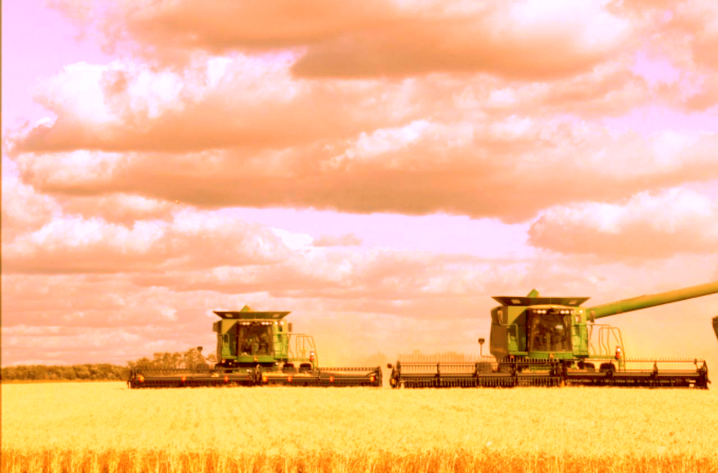
ECLSS
- Farming lowers O2 requirement,
heightens water / CO2 requirement
- Efficiency of water / gas recovery is critical
- Lighting power for plant is dominant
FARMING
- Farming lowers IMLEO, but requires much more power because of lighting
- Fertilizer is brought from Earth
- Farming is time consuming and detracts from research
ECLSS & FARMING
Notes:
#Adrien
o Key findings on power & crew time vs. % of food grown
o Risk associated with crop failure etc.

Slide 8
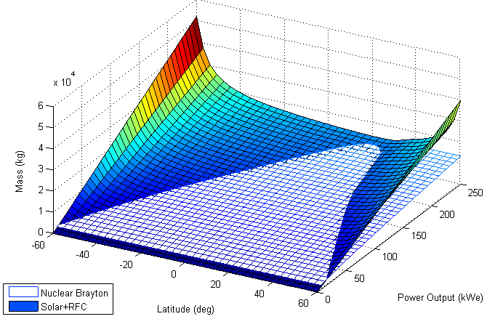
POWER
Nuclear Brayton Reactor
CO2 cooling medium
Does not require H20
Depending on the site location Solar has a lower Power-to-Weight ratio
ISRU
POWER & ISRU
Notes:
#Adrien
o What we produce, how we produce (roughly)
o Key enabler for mission
o Side note on lunar ISRU (possibly another slide on this)*

Slide 9
Option # | Produces | Method Name | Produces (kg/day) | ISRU Mass (kg) | ISRU Power Req (kW) | Chemical Reaction
1 | H20 | Soil Processing (3% or 8% H20 content in regolith) | 55.96, 11.95, or 7.15 kg of H20 based on large, medium, or small ISRU plant size | 413/248, 181/132, 149/116 kg large, medium, small | 2.02/1.88, 1.47/1.44, 1.41/1.39 kw large/medium/small with 3%/8% H20 content | N/A (evaporating water and condensing it)
2 | O2 + H2 | Water Electrolysis | 1 kg H2 and 8 kg O2 scale. from 9 kg water estimated nominal production is 4 kg H2 and 32 kg O2 per day from 36 kg H20 | 38.5 kg | 72 kWh (kilowatt hour) per kg of H2 | 2H20 → 2H2 + O2
3 | 1 kg propellant (LOX/CH4) | Sabatier + electrolysis of all available water | input: 0.57 kg H20 and 0.70 kg C02 (from atmosphere) produces: 1kg propellant (LOX/CH4) with mixture of 2.93 Oxygen to Methane | 30 kg | 8.62 kWh assuming 50% efficiency penalty | CO2 + 4 H2 → CH4 + 2 H2O + energy
4 | CH4 + H20 | Sabatier only (maximum water production) | Requires H2 brought from earth, excluding from tradespace | 30 kg | N/A | CO2 + 4 H2 → CH4 + 2 H2O + energy
5 | O2 | Atmospheric Processing | 52.8 of O2 | 1000 kg | 50 kW | CO2 → O2 + CO
Resource Requirements
Notes:
#Adrien
o What we produce, how we produce (roughly)
o Key enabler for mission
o Side note on lunar ISRU (possibly another slide on this)*

Slide 10
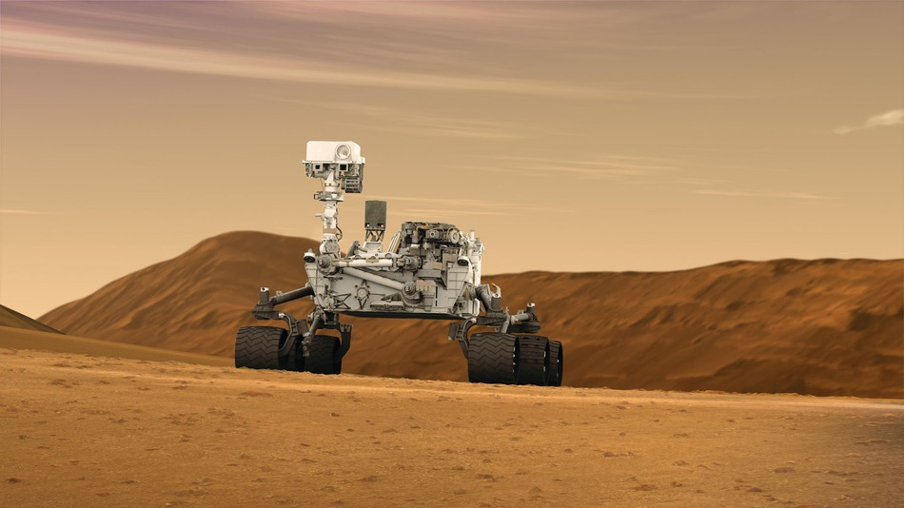

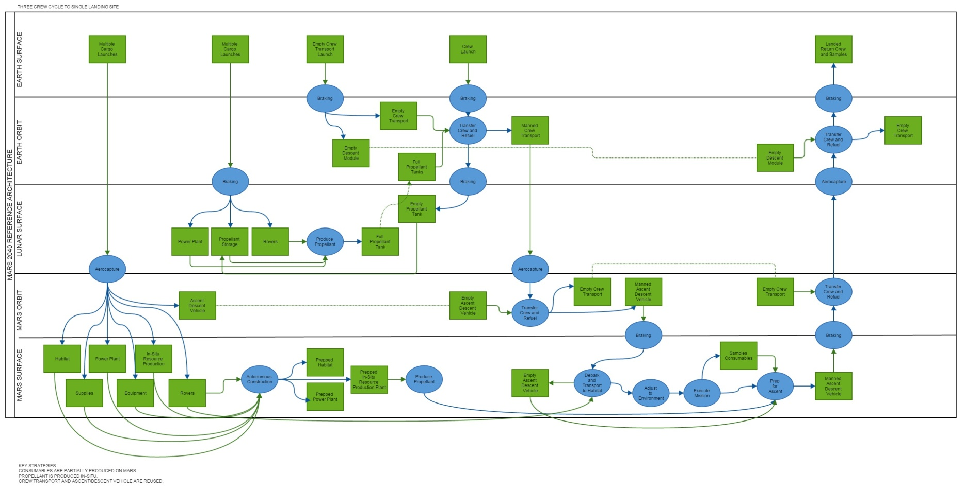
LISA : IF YOU NEED TEXT ON HERE, LET ME KNOW
LOGISTICS CONCEPT OF OPERATIONS

Slide 11
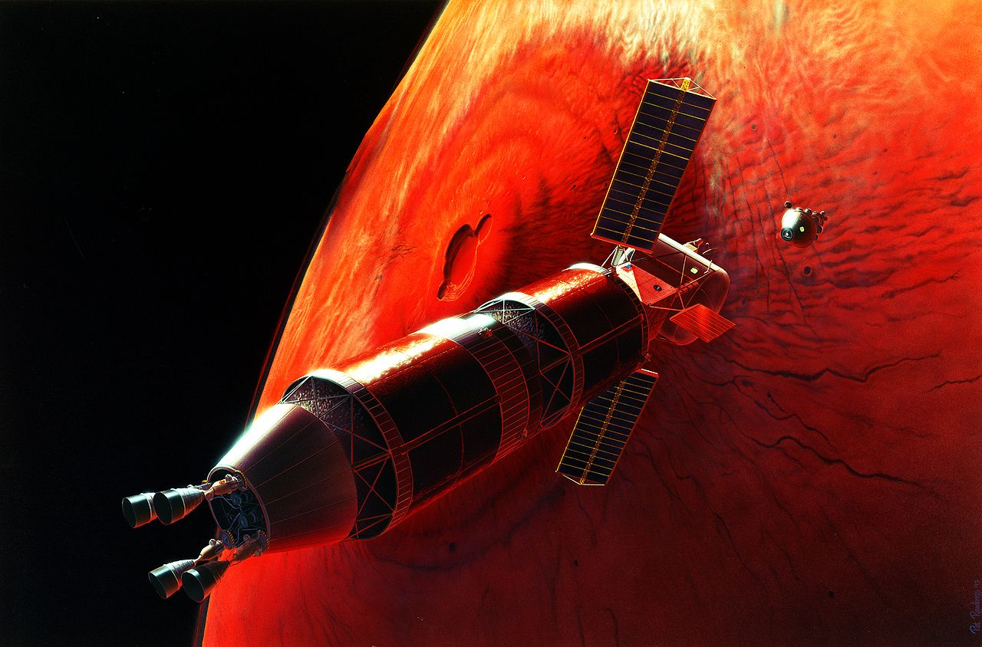

Propulsion (1 slide) Key Points:
o Need for advance space propulsion (getting there and coming back is difficult)
o NTR usually a clear advantage
o Key enabler may be lunar O2
o SEP, VASIMR for cargo possibility?
PROPULSION

Slide 12
EDL (1 slide) Key Points:
o We’ve never landed anything heavier than 1t; demonstration needed for heavier mass -> need to land 40t
o Aerocapture vs. Propulsive capture (?)
ENTRY, DESCENT AND LANDING

Slide 13

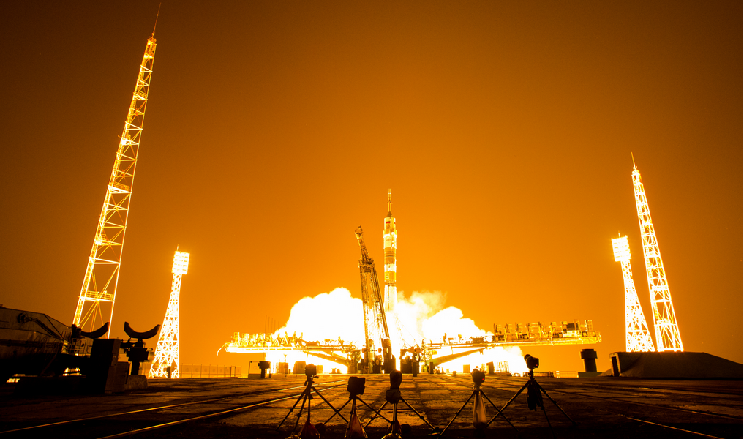
Current ISS budget -> $3b/yr
· Current Payload cost -> ~$5k~$10k/kg; IMLEO -> ~$1.5b~$3b/yr for launch only, using lowest estimate
o ISS budget ~$3b/yr for ISS only for 2014, and launch cost accounts for 34%. So, $4.5~$9b/yr in operation cost for Mars (3x the launch cost)
· NASA Budget (http://www.nasa.gov/sites/default/files/files/NASA_FY_2016_Budget_Estimates.pdf) & ISS Operating Cost (http://oig.nasa.gov/audits/reports/FY14/IG-14-031.pdf)
· At $1k/kg, the operation cost becomes, < $1b/yr for Mars. (2x the projected/announced cost per SpaceX)
o Account for lunar O2; getting it in LEO -> incentive for companies to provide O2 at < $1k/kg in LEO
§ Accounting for lunar O2, this will add about $350m/yr for lunar O2 case. Total will be about $1b/yr for NTR, $1.4b/yr
o International Partners Potential:
§ Provide O2 in LEO, provide Cargo Transport (SEP, etc.), Power Modules, EDL system?
FINANCIAL IMPLICATIONS

Slide 14
· PM-wise (1 slide) -> Pathway to Exploration Report (to be reviewed), follow similar road.
PROJECT MANAGEMENT

Slide 15
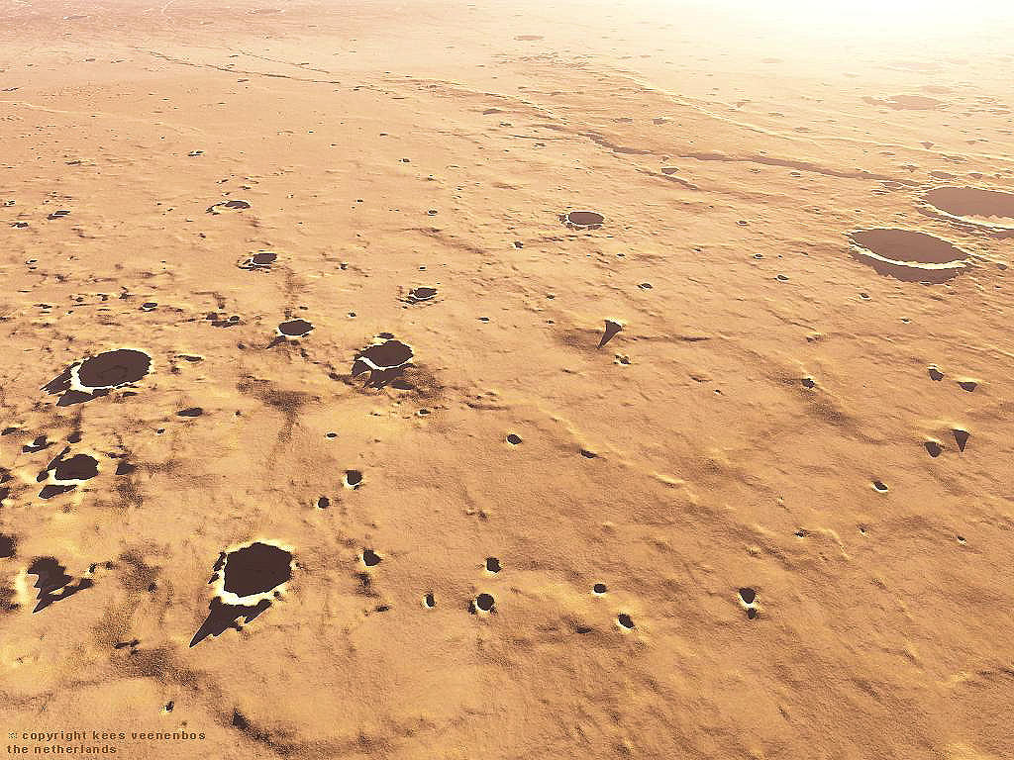
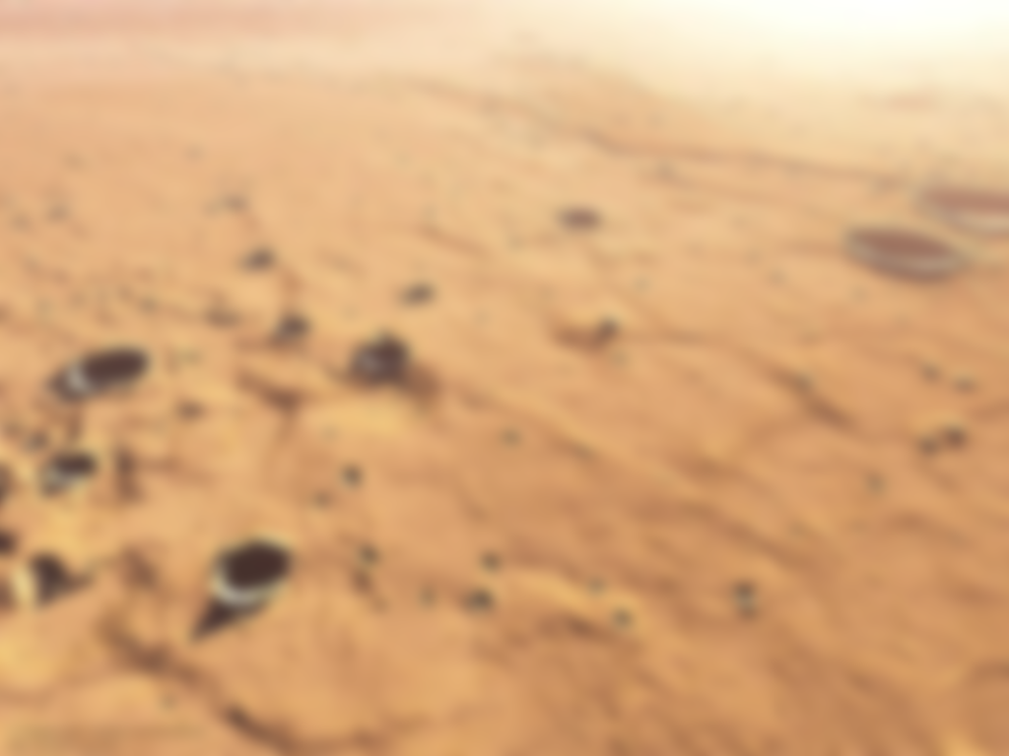
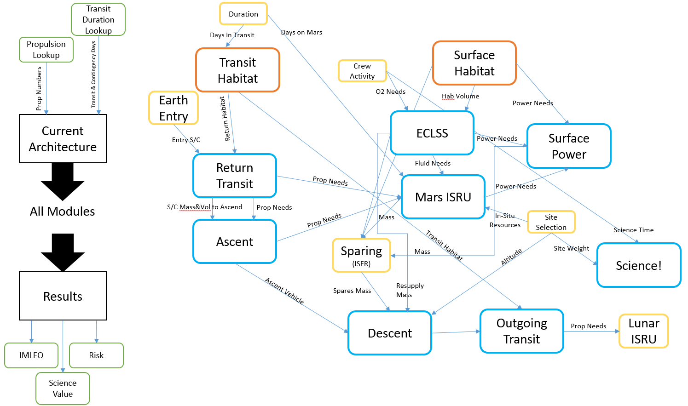
MODEL AND TOOL DEVELOPMENT: Construction
Notes:
Originally created a complete multi-level OPD of the system and how the different sub-systems interacted, then converted to top-level diagram for easier readability.
This was the basis of coding the various modules in Matlab, with the functional modules mapped consistently to the Mars Campaign formal sub-systems.

Slide 16
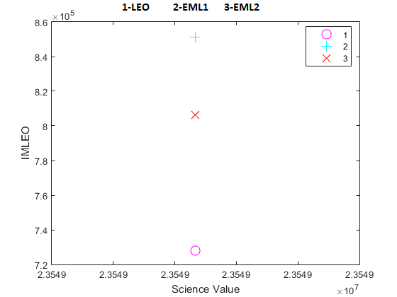
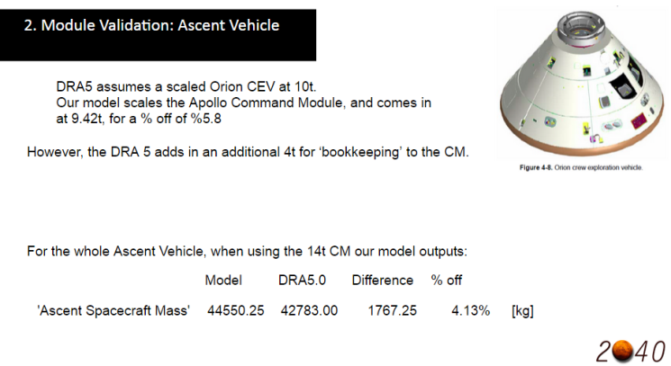
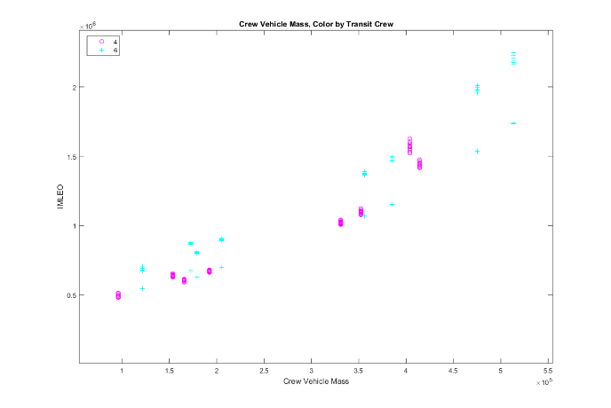
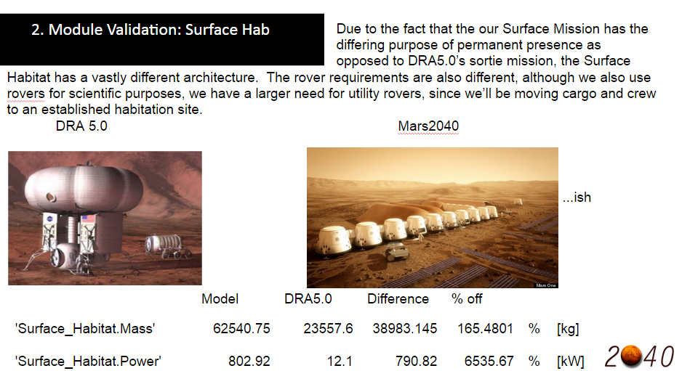
Verification…
…and Validation
MODEL AND TOOL DEVELOPMENT: V&V
Notes:
Verification was done through multiple single variable model runs, verifying that the output matches the expectation of the effect of that variable. This was repeated for each input variable with the others fixed at the baseline values.
Further Verification was performed by enumerating two input variables who's effects were expected to interact, and insuring that the model demonstrated the correct behavior.
Validation was done through comparison to NASA DRA5. Since the Level -1 Architecture was quite disparate (ie. DRA5 evaluated single stay mission architectures and Mars 2040 evaluated permanently occupied campaign architectures) some variables were locked down to evaluate the code on a module-by-module basis.

Slide 17
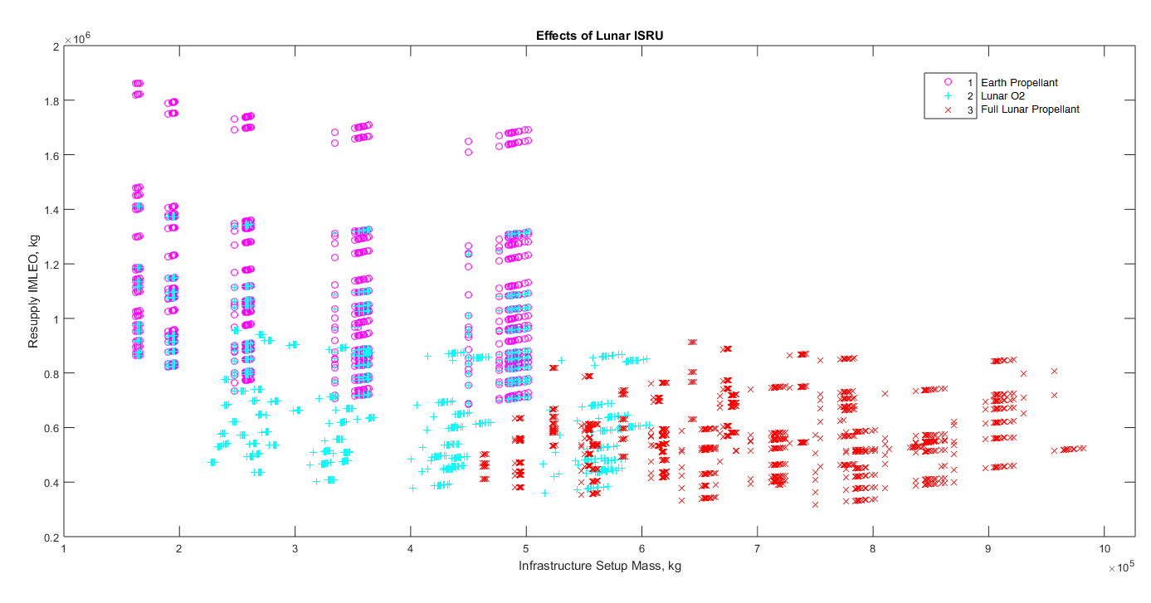
7908:
IMLEO: 68.4 mt
Infrastr: 45.0 mt
TranO2--TranFuel
EARTH----EARTH
8628:
IMLEO: 37.88 mt
Infrastr: 51.6 mt
TranO2--TranFuel
LUNAR----EARTH
7188:
IMLEO: 31.79 mt (-16%)
Infrastr: 75.0 mt (+45%)
TranO2--TranFuel
LUNAR----LUNAR
INFRASTRUCTURE vs IMLEO COST TRADE
Notes:
Lunar ISRU significantly increases the emplaced infrastructure mass, but reduces the resupply mass in low earth orbit (IMLEO.)
Notice the Lunar ISRU also reduces the variability in IMLEO, especially full Lunar IMLEO (LH2 and LOX.)
However, compare the benefits of the best IMLEO architectures, with the only difference being Lunar O2 (only) or Full Lunar Propellant. Consider Architecture Numbers 8629 and 7188 (details below), Full Lunar ISRU costs 1.45 times the infrastructure mass, while only reducing the IMLEO by 16%.
Additionally there is a large benefit of having Lunar O2 production Arch 7908 is the same as the previous with full Earth Propellant, and it comes in at 68.4 mt resupply IMLEO (up 83%) and 45.0 mt Infrastructure mass (down only about 12%).
Note that this 3-step curve is only valid when not using NTR, which has no need for O2, it shows no difference between Earth Propellant and Lunar O2 only (see the overlapping circles and plusses in this graph.)
Other (shared) Architectural Options for these points:
Propulsion Type:
LH2
Staging point:
Low Earth Orbit
RetO2---RetFuel
MARS----MARS
Transit Crew
4
Surface Crew
24
Site
PLANUS_BOREUM
Orbit Capture
Aerocapture
Surface Power
SOLAR
% food grown on Mars
100

Slide 18
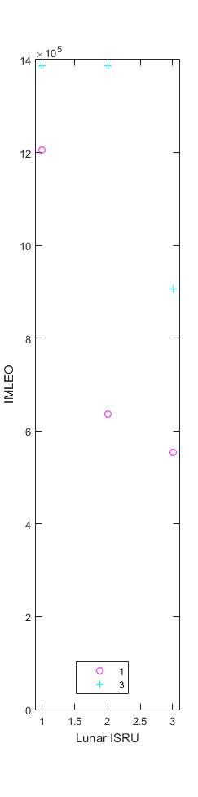
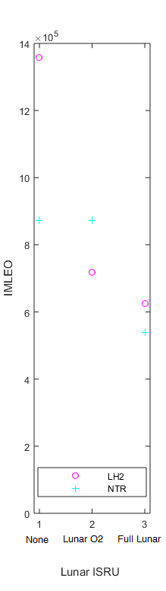
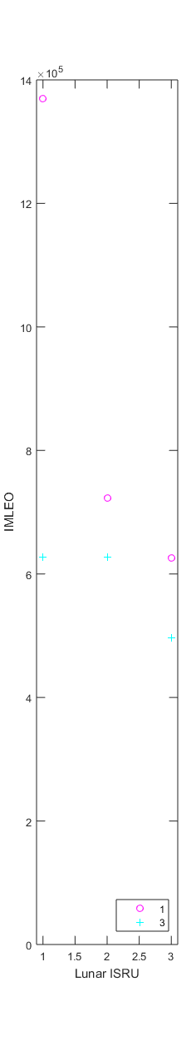
Improved Chemical
Improved NTR
Nominal
Sensitivity Analysis: Propulsion
Notes:
The nominal assumptions take the generally agreed average capabilities of these engines, NTR with an Isp of 850, eventhough upwards of 1500 has been theorized, and LH2 engines use a pretty averane Isp of 448, close to the Space Shuttle Main Engines, and an average 0.17 Inert Mass Ratio, even though lower has been demonstrated.
Improved Chemical assumes an inert mass ratio of .1 instead of .17, and Improved NTR assumes an improved Isp of 1500 instead of 850.

Slide 19
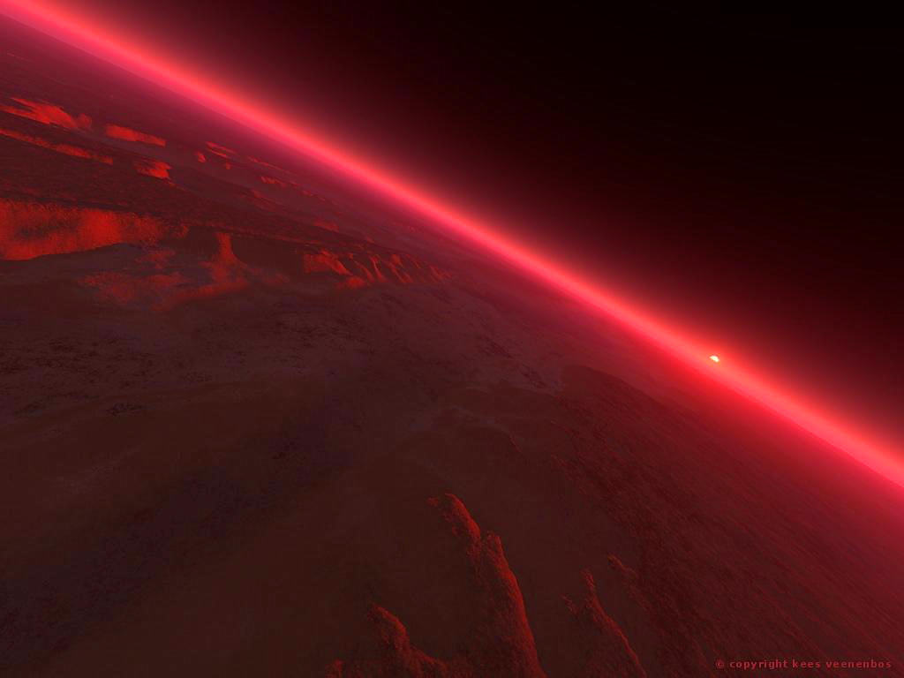

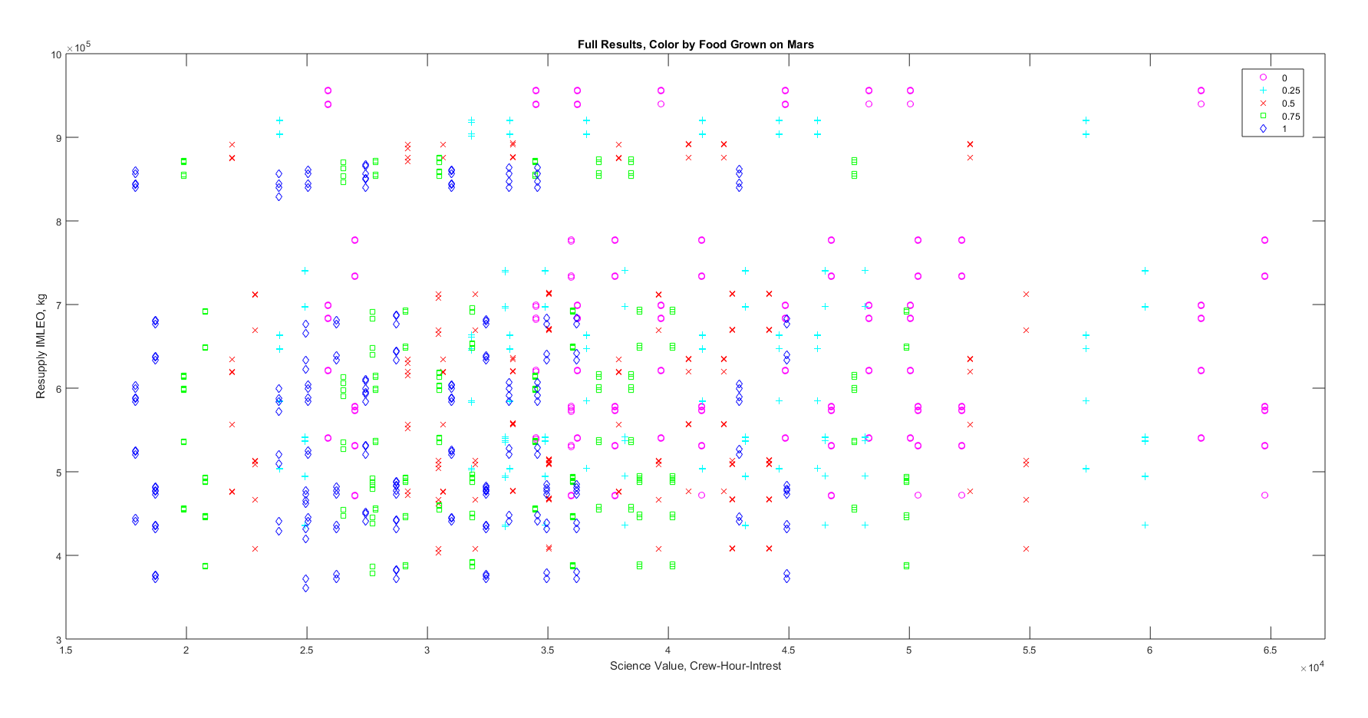
1337
1400
RECOMMENDED ARCHITECTURE
Notes:
#Adrien
1337 is at Gusev Crater with Nuclear Power, 50% food grown, 1440 at Amazonis with Solar Power, 25% food grown
Architectures 1337 and 1440 are of particular interest since they balance Science Time and IMLEO. Furthermore, with 50 and 25% of food grown on Mars (respectively,) these architectures would go a long way to prove that it can be done, and set the stage for more permanent colonization in the future.
The 1337- like Architecture 1338 has 100% food grown, but this minimizes the time available for Science, since the crew members would spend a very large portion of their efforts as farmers (but at least farmers on Mars!)
Morph{1337}
Propulsion Type:
LH2
Staging point:
Low Earth Orbit
TranO2--TranFuel
LUNAR----EARTH
RetO2---RetFuel
MARS----MARS
Transit Crew
4
Surface Crew
24
Site
GUSEV
Orbit Capture
Aerocapture
Surface Power
NUCLEAR
% food grown on Mars
50
Morph{1440}
Propulsion Type:
LH2
Staging point:
Low Earth Orbit
TranO2--TranFuel
LUNAR----EARTH
RetO2---RetFuel
MARS----MARS
Transit Crew
4
Surface Crew
24
Site
AMAZONIS
Orbit Capture
Aerocapture
Surface Power
SOLAR
% food grown on Mars
25

Slide 20
Water is very useful (get oxygen, radiation protection, etc.)
ISRU is a key enabler, including lunar resource development; LEO is likely a better staging point than ELM2
Farming is hard (high crew cost vs. low gain in IMLEO)
Based on planned ~2 launches of SLS/year, continued Mars mission is likely very difficult
Key technology roadmap – robotics (for farming), improved nuclear (i.e. no moving part or fluid, increase efficiency from current ~30%)
Appreciation of what we have here on earth based on the difficulty that we face
SDM related: PM is very important.
MarsOne is full of crap etc…
CONCLUSIONS AND KEY FINDINGS
Notes:
#Adrien

Slide 21
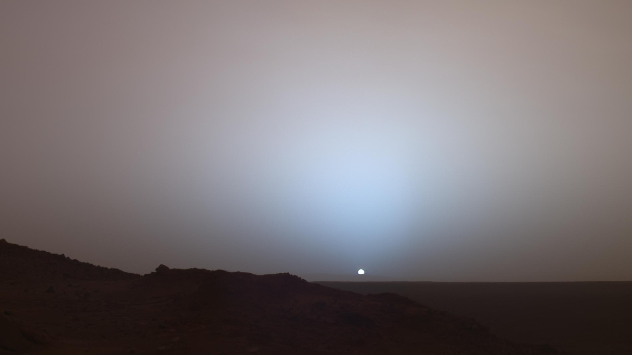

Risk Analysis
Subsystem Trade etc.
Many assumptions made – including lunar O2, NTR, storage H2.
CAVEATS AND LIMITATIONS

Slide 22

THANK YOU – MENTION UROPS, POST DOCs, OLI.

Slide 23
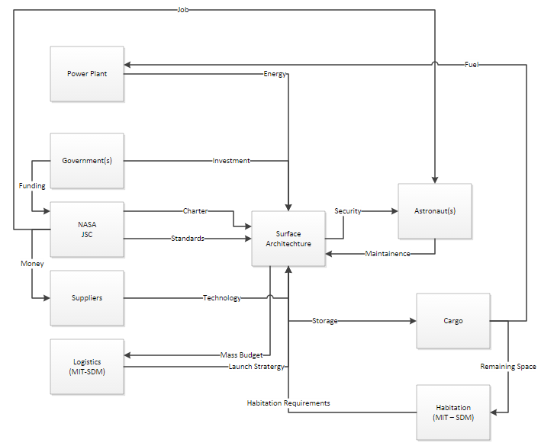
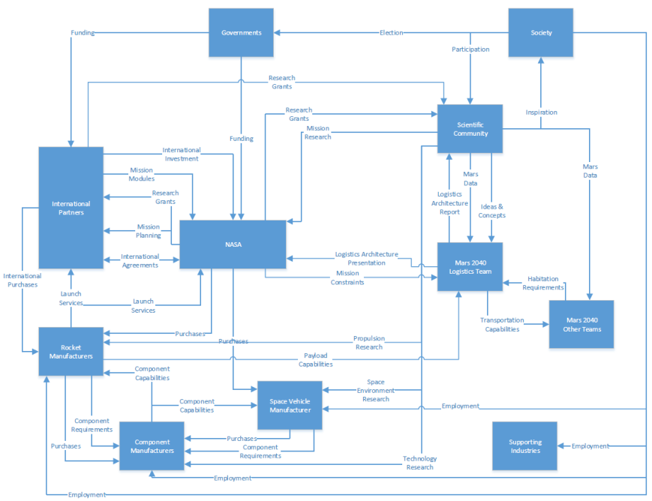
Tools/Methods Supporting Slides – Stakeholder Value Network
Surface Architecture
Logistics
SDM METHODOLOGIES USED
Notes:
Many tools were used during the project. In the slide above you see the four tools that were utilized the most. The project initially started by putting together a morphological matrix to explain the tradespace that was going to be analyzed. After the morphological matrix was created the decision was made to reduce the matrix to the top 10 decisions for each team to reduce the amount of overall tradespace variables available. A DSM was then created to determine the interactions between the matrix variables to illustrate the communications that needed to take place in order to complete the tradespace analysis.

Slide 24
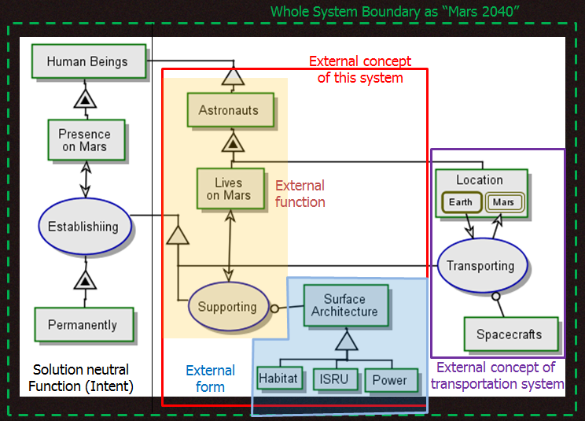
Tools/Methods Supporting Slides – Surface Architecture Level 1
SDM METHODOLOGIES USED
Notes:
Many tools were used during the project. In the slide above you see the four tools that were utilized the most. The project initially started by putting together a morphological matrix to explain the tradespace that was going to be analyzed. After the morphological matrix was created the decision was made to reduce the matrix to the top 10 decisions for each team to reduce the amount of overall tradespace variables available. A DSM was then created to determine the interactions between the matrix variables to illustrate the communications that needed to take place in order to complete the tradespace analysis.

Slide 25
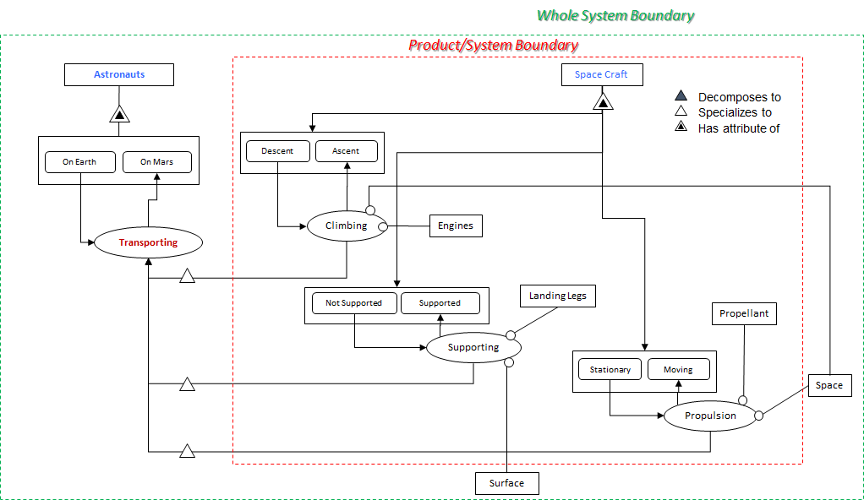
Tools/Methods Supporting Slides – Surface Architecture Level 1
SDM METHODOLOGIES USED
Notes:
Many tools were used during the project. In the slide above you see the four tools that were utilized the most. The project initially started by putting together a morphological matrix to explain the tradespace that was going to be analyzed. After the morphological matrix was created the decision was made to reduce the matrix to the top 10 decisions for each team to reduce the amount of overall tradespace variables available. A DSM was then created to determine the interactions between the matrix variables to illustrate the communications that needed to take place in order to complete the tradespace analysis.

Slide 26
Tools/Methods Supporting Slides – Full Morphological Matrix
1 | Human Trajectory | Conjunction | Oposition | Cycler | Elliptical
2 | Cargo Trajectory | Hohman (Conjunction) | Opposition Also | Spiral | Elliptical | Same
3 | Staging | LEO | EML1 | LLO | None | EML2 | Lunar DRO
3.5 | Addt'l Destinations (ISRU) | Lunar | Captured Asteroid | Mars Moon | None
4 | Transit Fuel Source | Earth | Lunar ISRU | Asteroid ISRU
5 | Return Fuel Source | Earth | Lunar ISRU | Mars ISRU
6 | Propulsion | Chemical (LOX/H2) | NTR | SEP
7 | EDL | Propulsive | Aerobraking | Aerocapture
8 | Transit Rad Sheild Mat'l | Water | Cargo | Dedicated
9 | Transit Rad Sheilding | Permanent | Temporary | None
10 | Transit Hab Size | Minimal | 10 m^3/astronaut | Spacious
11 | Site Selection | Gusev Crater | Holden Crater | Mawrth Vallis | Gale Crater
12 | Base of ISRU | None (launch from Earth) | Soil processing | Atmoshere Processing | Both
13 | Gas Processing | O2 Only | O2/CH4 | O2/CH4 | O2/CH4 | Buffer Gases included
14 | ISRU Use | None | Gas Processing/Fuel | Water Sources
15 | Food Supply | Grow crop | Send from Earth | Hybrid
16 | Radiation Protection | None | Covered in Regolith | Buried | Lava tube | Water/Ice | Aluminum
17 | Structure | Fixed Shell Modules | Inflatable Modules | Hybrid - fixed w/ inflatable modules (&tunnels)
18 | Number of sites | 1 | 2 | 4 | 5
19 | ISFR Consumables | None (spares sent from Earth) | Polymer production | Metal production
20 | Surface Power | Solar | Fuel Cells (H2O) | RTGs (DIPS) | Nuclear (Fission) | Hybrid
SDM METHODOLOGIES USED
Notes:
Many tools were used during the project. In the slide above you see the four tools that were utilized the most. The project initially started by putting together a morphological matrix to explain the tradespace that was going to be analyzed. After the morphological matrix was created the decision was made to reduce the matrix to the top 10 decisions for each team to reduce the amount of overall tradespace variables available. A DSM was then created to determine the interactions between the matrix variables to illustrate the communications that needed to take place in order to complete the tradespace analysis.

Slide 27
Tools/Methods Supporting Slides – Reduced Morphological Matrix
Crew Exchange |  | 4 | 6
Crew Stay Duration | 500 | 1280 | 2060
Human Trajectory | Conjunction
Cargo Trajectory | Hohman (Conjunction)
Staging | LEO | EML1 | EML2
Transit Fuel Source | Earth | Lunar ISRU
Return Fuel Source | Earth | Lunar ISRU | Mars ISRU
Propulsion | Chemical (LOX/H2) | NTR | SEP | Chemical (CH4?)
EDL? | Aerocapture
Transit Rad Sheild Mat'l | Water
Transit Rad Sheilding | Temporary (local areas)
Site Selection |  | Holden Crater |  | Gale Crater
Base of ISRU |  |  |  | Both
Gas Processing | Yes
ISRU Use | Fuel | Fuel and ECLSS | None
Food Supply | 0% | 25% | 50% | 75% | 100%
Number of sites | 1
ISFR Consumables | None
SDM METHODOLOGIES USED
Notes:
Many tools were used during the project. In the slide above you see the four tools that were utilized the most. The project initially started by putting together a morphological matrix to explain the tradespace that was going to be analyzed. After the morphological matrix was created the decision was made to reduce the matrix to the top 10 decisions for each team to reduce the amount of overall tradespace variables available. A DSM was then created to determine the interactions between the matrix variables to illustrate the communications that needed to take place in order to complete the tradespace analysis.

Slide 28
Tools/Methods Supporting Slides – Full DSM
Element Name |  | 1 | 2 | 3 | 4 | 5 | 6 | 7 | 8 | 9 | 10 | 11 | 12 | 13 | 14 | 15 | 16 | 17 | 18 | 19 | 20 | 21 | 22 | 23 | 24 | 25 | 26 | 27 | 28 | 29 | 30 | 31 | 32 | 33 | 34 | 35 | 36 | 37 | 38 | 39 | 40
Science | 1 | 1
Trips | 2 |  | 2 | 1
# Astronauts | 3 |  | 1 | 3 |  | 1 |  |  |  |  |  |  |  |  |  |  |  |  |  |  |  | 1
Stay Length | 4 | 1 |  | 1 | 4 | 1 | 1 |  |  |  |  |  |  |  |  |  |  |  |  |  |  | 1
# Return | 5 | 1 |  | 1 | 1 | 5 |  |  |  |  |  |  |  |  |  |  |  |  |  |  |  | 1
Destinations | 6 | 1 |  |  |  |  | 6
Staging Points | 7 |  |  |  |  |  | 1 | 7 | 1 |  |  |  |  | 1
Deployment | 8 |  |  |  |  |  | 1 |  | 8 |  |  |  |  |  |  |  |  |  |  |  |  | 1 | 1 | 1 |  |  |  | 1 | 1 |  |  | 1
Propulsion | 9 |  |  | 1 |  |  |  | 1 | 1 | 9
Transit Orbit | 10 |  | 1 |  | 1 |  |  | 1 |  |  | 10 | 1 | 1 | 1 | 1 | 1 |  |  |  |  |  |  |  |  |  |  |  |  |  |  |  |  |  |  |  |  |  |  | 1
Mars Descent | 11 |  |  | 1 |  |  |  | 1 | 1 |  | 1 | 11 |  |  |  |  |  |  |  |  |  | 1 |  | 1 |  |  |  | 1 | 1 |  |  | 1
Earth Descent | 12 |  |  |  |  | 1 |  | 1 |  |  | 1 |  | 12
Mars Fuel | 13 |  |  |  |  |  |  | 1 | 1 | 1 | 1 | 1 |  | 13 |  |  |  |  | 1 |  |  |  |  | 1 |  |  |  | 1 | 1 |  |  | 1
Return Fuel | 14 |  |  |  |  |  |  | 1 |  | 1 | 1 |  | 1 |  | 14 |  |  |  | 1
Launch Freq. | 15 |  |  |  |  |  | 1 |  | 1 |  | 1 |  |  | 1 | 1 | 15 |  |  |  |  |  | 1 | 1
ISRU ECLSS | 16 |  |  | 1 | 1 | 1 |  |  |  |  |  |  |  |  |  |  | 16 |  |  |  |  | 1 |  |  |  |  |  |  |  |  |  |  |  |  |  |  |  | 1
ISRU Dev | 17 |  |  |  |  |  | 1 |  | 1 |  |  |  |  |  | 1 |  | 1 | 17 | 1 | 1 | 1 |  |  |  | 1 |  |  |  |  | 1 |  |  |  |  |  |  | 1
ISRU Use | 18 |  |  |  |  |  | 1 |  |  |  |  |  |  |  | 1 |  | 1 |  | 18 |  |  | 1 |  |  | 1 |  |  |  |  |  |  |  |  |  |  |  | 1 | 1
ISFR Consum. | 19 |  |  |  |  |  | 1 |  |  |  |  |  |  |  |  |  |  |  |  | 19 |  | 1
ISFR Cpk | 20 |  |  |  |  |  |  |  |  |  |  |  |  |  |  |  |  |  |  | 1 | 20
Base Locations | 21 | 1 |  |  |  |  |  |  |  |  |  |  |  |  |  |  |  |  |  |  |  | 21
Base proximity | 22 | 1 |  |  |  |  |  |  |  |  |  |  |  |  |  |  |  |  |  |  |  | 1 | 22 | 1
Base Style | 23 | 1 |  |  |  |  |  |  |  |  |  |  |  |  |  |  |  |  |  |  |  | 1 | 1 | 23 | 1
Rad. Protection | 24 |  |  |  |  |  |  |  |  |  |  |  |  |  |  |  |  |  |  |  |  | 1 |  |  | 24
Structural | 25 |  |  | 1 |  |  |  |  |  |  |  |  |  |  |  |  |  |  |  |  |  |  | 1 | 1 | 1 | 25
Rover Power | 26 |  |  |  |  |  |  |  |  |  |  |  |  |  |  |  |  |  |  | 1 |  |  |  |  |  |  | 26 | 1 | 1
Rover Style | 27 | 1 |  | 1 |  |  |  |  |  |  |  |  |  |  |  |  |  |  |  |  |  |  |  |  |  |  | 1 | 27
Rover Qty. | 28 |  |  | 1 |  |  |  |  |  |  |  |  |  |  |  |  |  |  |  |  |  |  |  |  |  |  | 1 | 1 | 28 |  |  | 1
Surf. Power | 29 |  |  | 1 |  |  |  |  |  |  |  |  |  |  |  |  |  | 1 | 1 | 1 | 1 |  |  |  |  |  |  |  |  | 29 |  |  |  |  |  | 1 | 1 | 1
Base Layout | 30 | 1 | 1 | 1 | 1 | 1 |  |  |  |  |  |  |  |  |  |  |  |  |  |  |  | 1 |  |  | 1 |  |  |  |  | 1 | 30 | 1 |  |  |  | 1 | 1 | 1 | 1
# Mod.s/Base | 31 |  |  | 1 | 1 | 1 |  |  |  |  |  |  |  |  |  |  | 1 |  |  |  |  | 1 |  |  |  |  |  |  |  |  | 1 | 31
Transport Atm. | 32 |  | 1 | 1 |  | 1 |  |  |  |  | 1 | 1 | 1 |  |  |  |  |  |  |  |  |  |  |  |  |  |  |  |  |  |  |  | 32
Surface Atm. | 33 | 1 |  | 1 | 1 | 1 |  |  |  |  |  |  |  |  |  |  | 1 |  |  |  |  |  |  |  |  |  |  |  |  |  | 1 |  |  | 33 |  | 1
EVA Atm. | 34 | 1 |  | 1 |  |  |  |  |  |  |  |  |  |  |  |  | 1 |  |  |  |  |  |  |  |  |  |  | 1 |  |  |  |  |  |  | 34 | 1
Food Prod. | 35 |  |  | 1 | 1 |  |  |  |  |  |  |  |  |  |  |  | 1 |  | 1 |  |  |  |  |  |  |  |  |  |  |  |  |  |  |  |  | 35
Water Prod. | 36 |  |  | 1 | 1 |  |  |  |  |  |  |  |  |  |  |  | 1 |  | 1 |  |  |  |  |  |  |  |  |  |  |  |  |  |  |  |  |  | 36
Air Prod. | 37 |  |  | 1 | 1 |  |  |  |  |  |  |  |  |  |  |  | 1 |  | 1 |  |  |  |  |  |  |  |  |  |  |  |  |  |  | 1 | 1 |  |  | 37
Emerg. Escape? | 38 |  | 1 | 1 | 1 |  |  |  |  |  | 1 |  |  |  |  |  |  |  |  |  |  | 1 | 1 | 1 |  |  |  |  |  |  |  |  | 1 |  |  |  |  |  | 38
IMLEO | 39 |  |  |  |  |  |  |  |  |  |  |  |  |  |  |  |  |  |  |  |  |  |  |  |  |  |  |  |  |  |  |  |  |  |  |  |  |  |  | 39
Value | 40 |  |  |  |  |  |  |  |  |  |  |  |  |  |  |  |  |  |  |  |  |  |  |  |  |  |  |  |  |  |  |  |  |  |  |  |  |  |  |  | 40
SDM METHODOLOGIES USED
Notes:
Many tools were used during the project. In the slide above you see the four tools that were utilized the most. The project initially started by putting together a morphological matrix to explain the tradespace that was going to be analyzed. After the morphological matrix was created the decision was made to reduce the matrix to the top 10 decisions for each team to reduce the amount of overall tradespace variables available. A DSM was then created to determine the interactions between the matrix variables to illustrate the communications that needed to take place in order to complete the tradespace analysis.

Slide 29
Tools/Methods Supporting Slides – Reduced Morphological DSM
Name | # | 16 | 12 | 13 | 17 | 20 | 18 | 19 | 14 | 15 |  | 7 | 4 | 5 | 6 | 1 | 2 | 3 | 11 | 9 | 10 | 8 | 21 | 22 | 23
Landing site Selection (Chris and Ryan) | 16 | 16
Basis of the ISRU (Adrien and Brad) | 12 | 1 | 12
What the ISRU will be used for (Adrien and Brad) | 13 | 1 |  | 13 |  |  |  |  |  |  |  |  | 1
Food Supply (Tatsuya) | 17 |  |  | 1 | 17
Radiation Protection (Aravind and Carlos) | 20 | 1 |  |  |  | 20
Activities for the Crew (Aravind and Carlos) | 18 |  | 1 | 1 | 1 | 1 | 18
Structure shape and style (Chris, Tatsuya and Lisa) | 19 |  |  |  |  |  |  | 19
Number of Habitats (Chris, Tatsuya and Lisa) | 14 | 1 |  |  |  |  | 1 |  | 14
Type (proximity?) of power plant (Alex) | 15 |  | 1 |  | 1 |  | 1 |  |  | 15
In Situ Sparing (ISFR) (Andrew Kurtz) | 6 |  | 1 | 1 |  |  |  |  | 1 |  | 6
FMMS | 24 |  | 1 | 1 | 1 | 1 |  | 1 | 1 | 1 |  | 24
Propulsion Type (Nathan) | 7 |  |  |  |  |  |  |  |  |  |  |  | 7
Addt'l Destinations (ISRU) (Nathan) | 4 |  |  |  |  |  |  |  |  |  |  |  |  | 4 | 1
Transit and Return Fuel Sources (Nathan, Brad) | 5 |  | 1 | 1 |  |  |  |  |  |  |  |  | 1 | 1 | 5
Human Trajectory (Greg) | 1 |  |  |  |  |  |  |  |  |  |  |  |  | 1 | 1 | 1
Cargo Trajectory (Greg) | 2 |  |  |  | 1 |  |  |  |  |  | 1 |  |  | 1 |  |  | 2
Staging (Greg and Eric) | 3 |  |  |  |  |  |  |  |  |  |  |  |  | 1 |  | 1 |  | 3
Transit Hab Size (Joe) | 11 |  |  |  |  |  |  |  |  |  |  |  |  |  |  | 1 |  |  | 11
Transit Rad Sheild Mat'l (Alex) | 9 |  |  |  |  |  |  |  |  |  |  |  |  | 1 |  | 1 |  | 1 |  | 9 | 1
Transit Rad Sheilding (Alex) | 10 |  |  |  |  |  |  |  |  |  |  |  | 1 | 1 |  | 1 |  | 1 | 1 | 1 | 10
EDL (Lisa) | 8 |  |  |  |  |  |  | 1 |  |  |  | 1 | 1 |  |  | 1 | 1 |  | 1 |  |  | 8
IMLEO | 21 |  |  | 1 | 1 | 1 |  | 1 | 1 |  | 1 |  | 1 |  | 1 |  |  |  | 1 | 1 | 1 | 1 | 21
Scientific Value | 22 | 1 |  |  |  |  | 1 |  |  | 1 |  |  |  |  |  | 1 |  |  |  |  |  |  |  | 22
Scenario Risk | 23 |  |  |  |  |  |  |  |  |  |  |  |  |  |  |  |  |  |  |  |  |  |  |  | 23
SDM METHODOLOGIES USED
Notes:
Many tools were used during the project. In the slide above you see the four tools that were utilized the most. The project initially started by putting together a morphological matrix to explain the tradespace that was going to be analyzed. After the morphological matrix was created the decision was made to reduce the matrix to the top 10 decisions for each team to reduce the amount of overall tradespace variables available. A DSM was then created to determine the interactions between the matrix variables to illustrate the communications that needed to take place in order to complete the tradespace analysis.

Slide 30
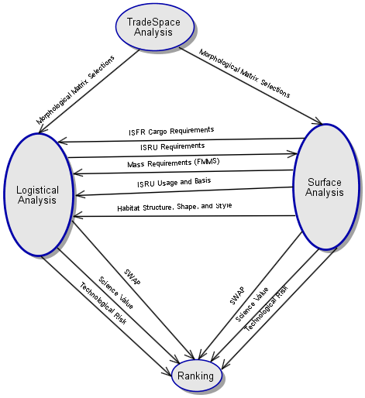
Tools/Methods Supporting Slides – OPM Diagrams
SDM METHODOLOGIES USED
Notes:
Many tools were used during the project. In the slide above you see the four tools that were utilized the most. The project initially started by putting together a morphological matrix to explain the tradespace that was going to be analyzed. After the morphological matrix was created the decision was made to reduce the matrix to the top 10 decisions for each team to reduce the amount of overall tradespace variables available. A DSM was then created to determine the interactions between the matrix variables to illustrate the communications that needed to take place in order to complete the tradespace analysis.

Slide 31
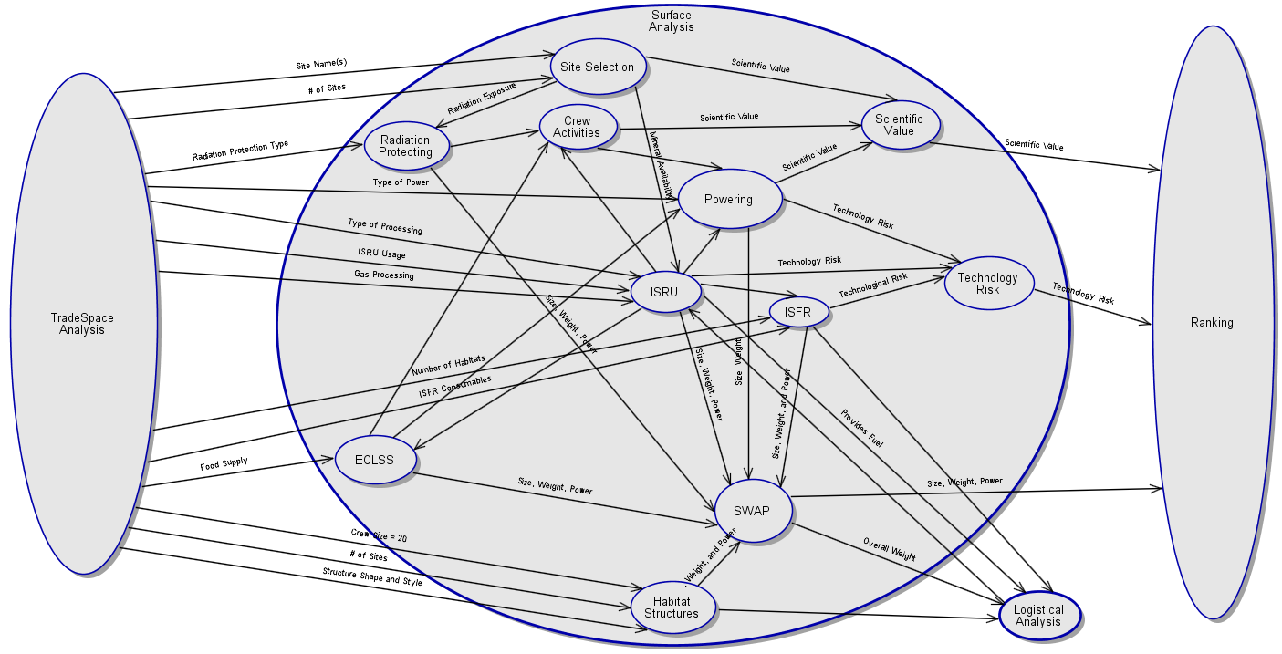
Tools/Methods Supporting Slides – OPM Diagrams (Surface Architecture)
SDM METHODOLOGIES USED
Notes:
Many tools were used during the project. In the slide above you see the four tools that were utilized the most. The project initially started by putting together a morphological matrix to explain the tradespace that was going to be analyzed. After the morphological matrix was created the decision was made to reduce the matrix to the top 10 decisions for each team to reduce the amount of overall tradespace variables available. A DSM was then created to determine the interactions between the matrix variables to illustrate the communications that needed to take place in order to complete the tradespace analysis.

Slide 32
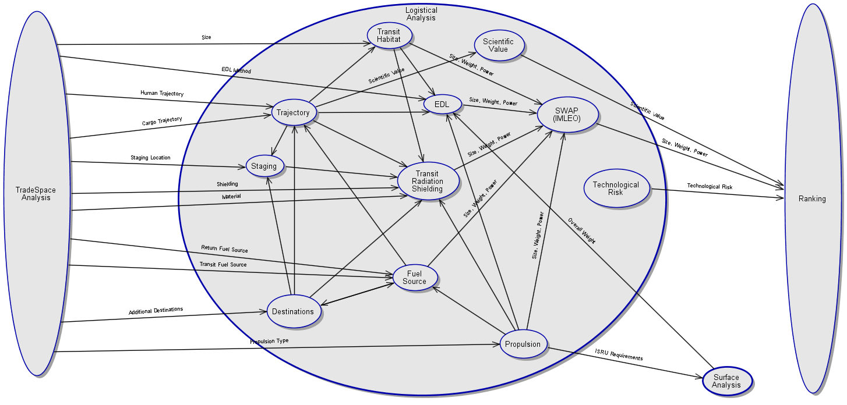
Tools/Methods Supporting Slides – OPM Diagrams (Logistics)
SDM METHODOLOGIES USED
Notes:
Many tools were used during the project. In the slide above you see the four tools that were utilized the most. The project initially started by putting together a morphological matrix to explain the tradespace that was going to be analyzed. After the morphological matrix was created the decision was made to reduce the matrix to the top 10 decisions for each team to reduce the amount of overall tradespace variables available. A DSM was then created to determine the interactions between the matrix variables to illustrate the communications that needed to take place in order to complete the tradespace analysis.

Slide 33
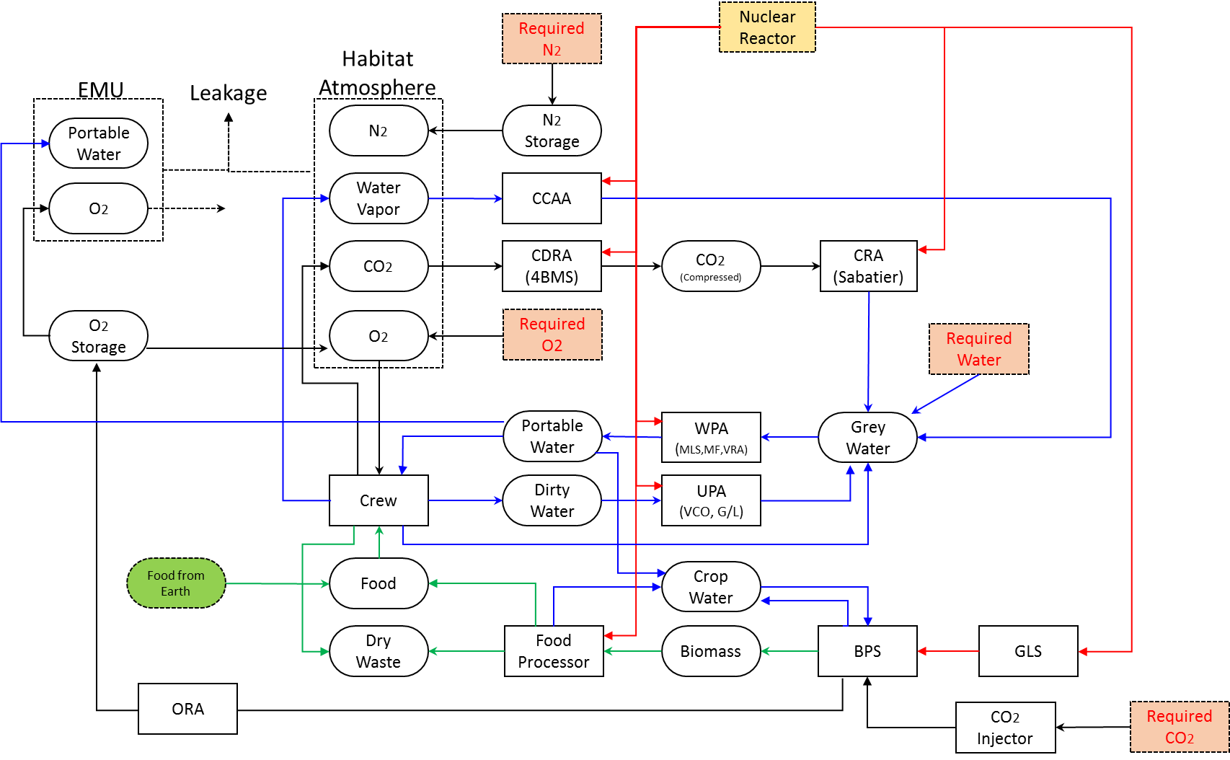
ECLSS Backup Slide
ECLSS Network Topology Map
ECLSS & FARMING

Slide 34
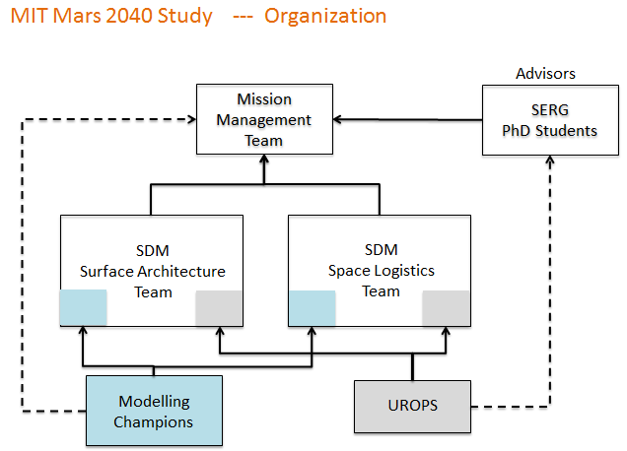
Supporting Slides – Charter/Scope Adjustments
SDM METHODOLOGIES USED
Notes:
Many tools were used during the project. In the slide above you see the four tools that were utilized the most. The project initially started by putting together a morphological matrix to explain the tradespace that was going to be analyzed. After the morphological matrix was created the decision was made to reduce the matrix to the top 10 decisions for each team to reduce the amount of overall tradespace variables available. A DSM was then created to determine the interactions between the matrix variables to illustrate the communications that needed to take place in order to complete the tradespace analysis.

Slide 35
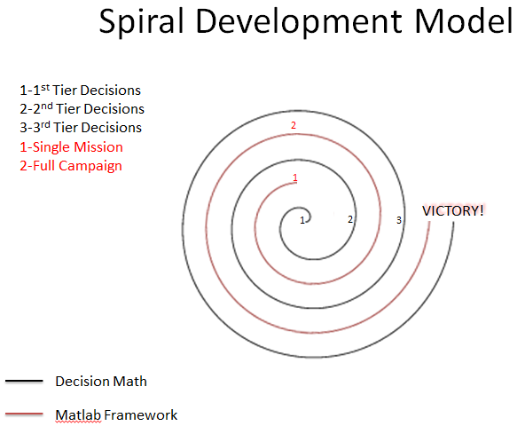
Supporting Slides – Development Model
SDM METHODOLOGIES USED
Notes:
Many tools were used during the project. In the slide above you see the four tools that were utilized the most. The project initially started by putting together a morphological matrix to explain the tradespace that was going to be analyzed. After the morphological matrix was created the decision was made to reduce the matrix to the top 10 decisions for each team to reduce the amount of overall tradespace variables available. A DSM was then created to determine the interactions between the matrix variables to illustrate the communications that needed to take place in order to complete the tradespace analysis.

